Slide 1
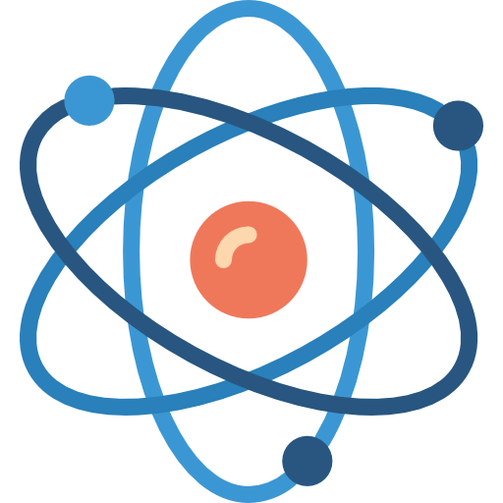
STRUCTURE OF ATOMS
​​

Slide 2
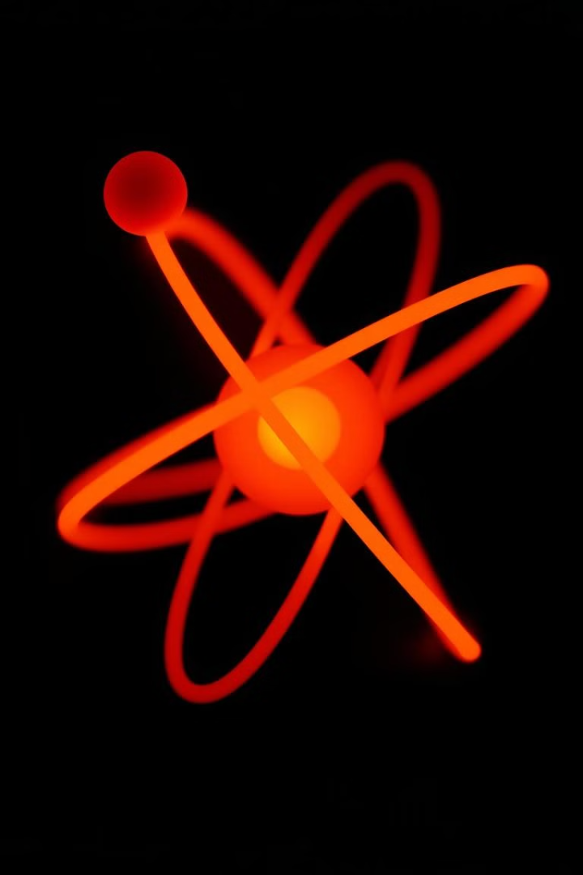
Introduction to Atoms
THE BASCIS
COMPOSITIONS
Atoms are the smallest units of an element that retain its chemical properties.
Atoms are made up of protons, neutrons, and electrons, arranged in a specific structure.
FUNDAMENTAL
Protons and neutrons make up the nucleus, while electrons orbit the nucleus.

Slide 3
Atomic Models: Dalton, Thomson, Rutherford
Thomson's Atomic Model
Rutherford's Atomic Model
Dalton's Atomic Model
Proposed atoms as indivisible, solid spheres that could not be created or destroyed.
Suggested atoms were composed of positively charged particles with negatively charged electrons embedded within.
Discovered the dense, positively charged nucleus at the center of the atom, with electrons orbiting it.

Slide 4
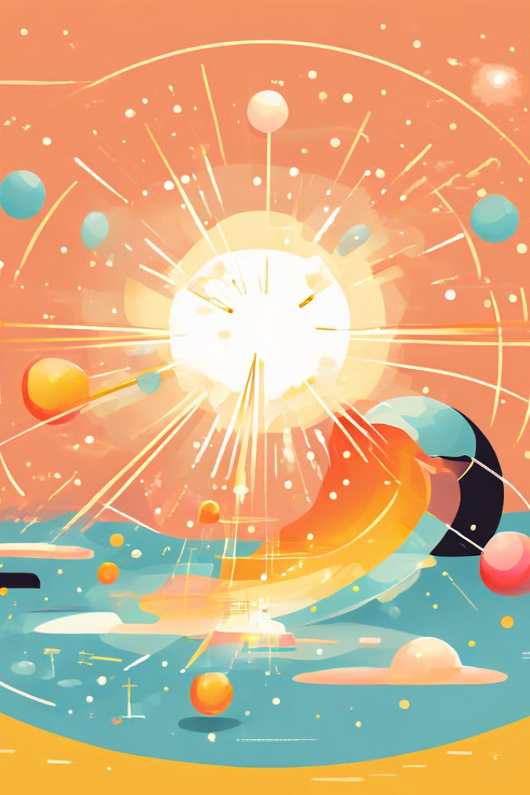
Rutherford's Gold Foil Experiment
1
Experimental Setup
Rutherford bombarded a thin gold foil with alpha particles and observed the resulting deflections.
2
Unexpected Findings
Most alpha particles passed through the foil undeflected, but a small number were deflected at large angles.
3
Atomic Structure
This led Rutherford to conclude that the atom had a small, dense, positively charged nucleus at its center.

Slide 5
Discovery of the Nucleus
Positive Charge
Density
Rutherford's experiment
showed that the positive charge of the atom was concentrated in a small central region, the nucleus.
The high-density nucleus occupies only a small fraction of the total volume of the atom.
Electron Orbits
Atomic Radius
The electrons orbit the nucleus in specific energy levels, rather than being randomly distributed
The size of an atom is determined by the radius of the electron orbits, not the size of the nucleus.
​

Slide 6
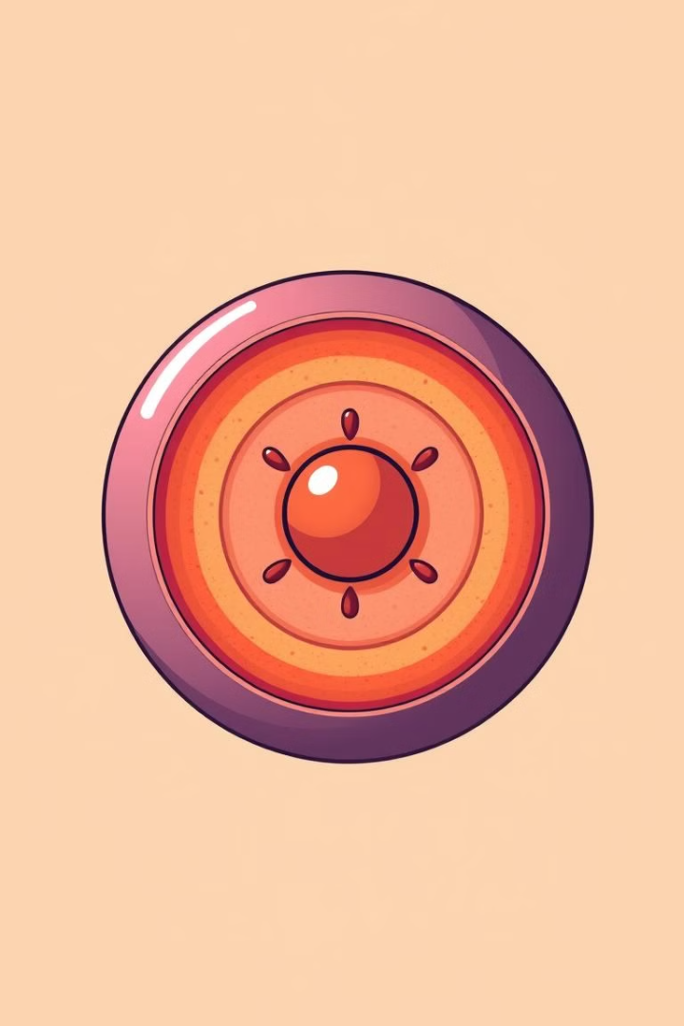




Characteristics of the Nucleus
Protons
Neutrons
Positively charged particles that make up the nucleus.
Uncharged particles that are also found in the nucleus.
Atomic Mass
Nuclear Energy
The total mass of protons and neutrons in the nucleus.
The immense energy released during nuclear reactions and fission.

Slide 7
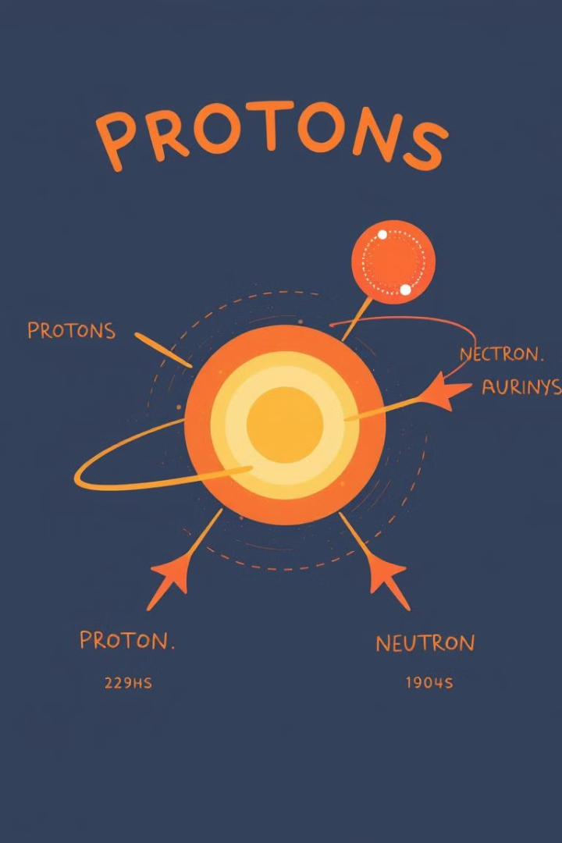
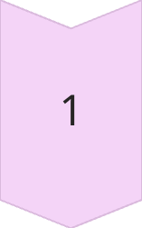
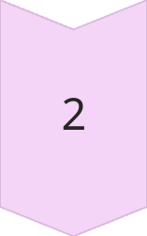
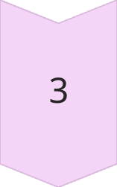
Protons and Neutrons
Protons
Positively charged particles that determine an element's identity.
Neutrons
Uncharged particles that add mass to the nucleus without changing the element.
Isotopes
Atoms with the same number of protons but different numbers of neutrons.

Slide 8
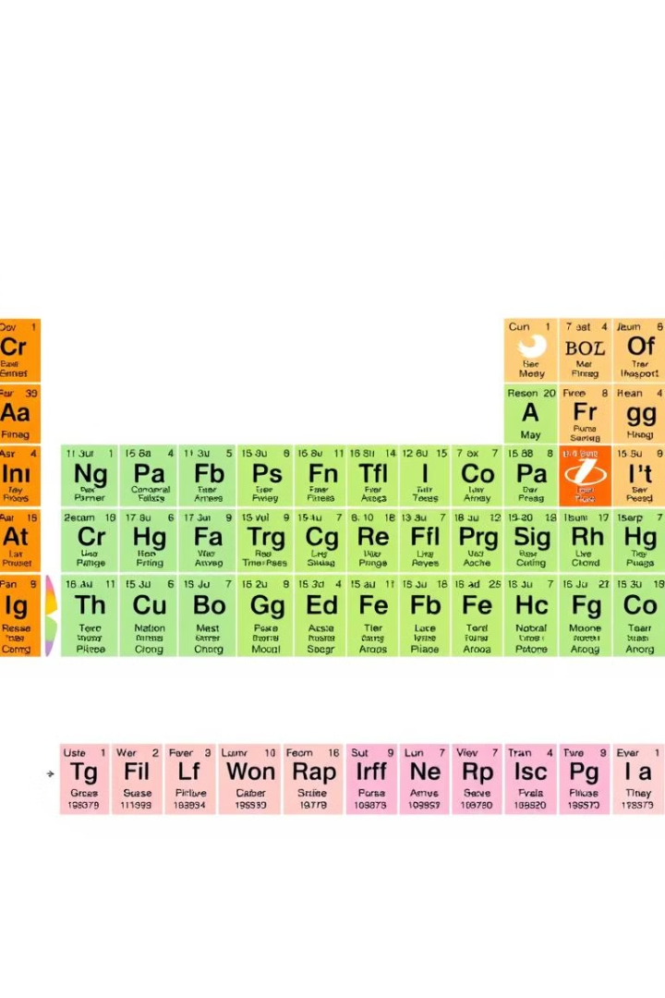
Atomic Number and Mass Number
Atomic Number
The number of protons in the nucleus, which defines the element's identity.
Mass Number
The total number of protons and neutrons in the nucleus, which determines the isotope.

Slide 9
Isotopes and Their Properties
Atomic Structure
Chemical Properties
Physical Properties
Isotopes have the same number of protons but different numbers of neutrons in the nucleus.
Isotopes of an element have nearly identical chemical properties due to the same number of protons.
Isotopes may have different physical properties, such as mass and stability, due to the varying number of neutrons.

Slide 10
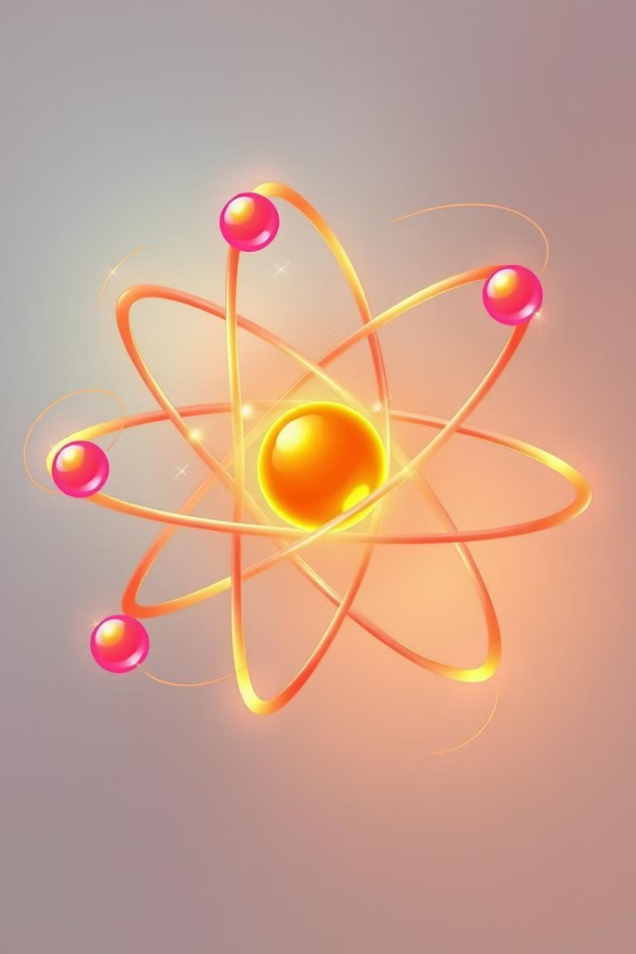
Conclusion and Key Takeaways
1
Atomic Structure
2
Nucleus and Electrons
Atoms are composed of protons, neutrons, and electrons arranged in a specific structure.
The nucleus contains protons and neutrons, while electrons orbit the nucleus in specific energy levels.
3
Isotopes and Properties
4
Groundbreaking Experiments
Atoms of the same element can have different numbers of neutrons, resulting in isotopes with unique properties.
The discovery of the atomic structure was driven by pioneering experiments, such as Rutherford's gold foil experiment.

Slide 11
Thank you
Our Team Members:-
NATHUL
HARI
KAASI
SURYA
RUDHRESH
KIRUTHIK PRANAV
PAVAN BALA
SANJITH RAM

